Slide 1
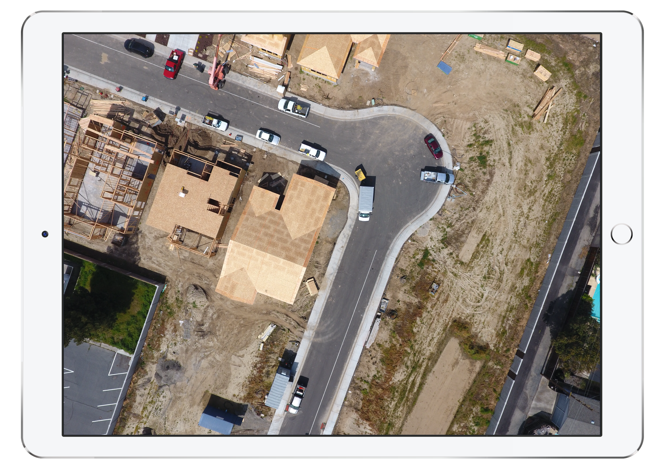

Slide 2
Auto-landing: READY
UNMATCHED
UNMATCHED
UNMATCHED
UNMATCHED
UNMATCHED
UNMATCHED
MATCHED
● TRACKING

Slide 3
